Slide 1
SMART AGRICULTURE SYSTEM USING IOT

Slide 2
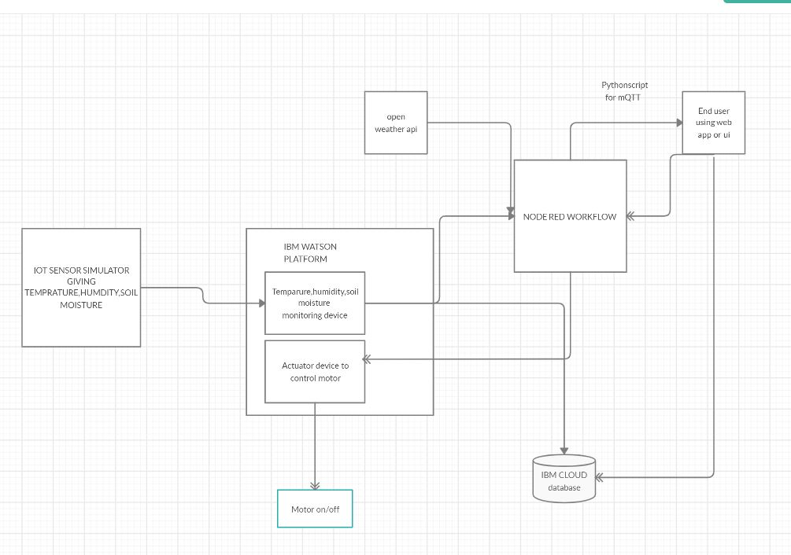
BLOCK DIAGRAM

Slide 3
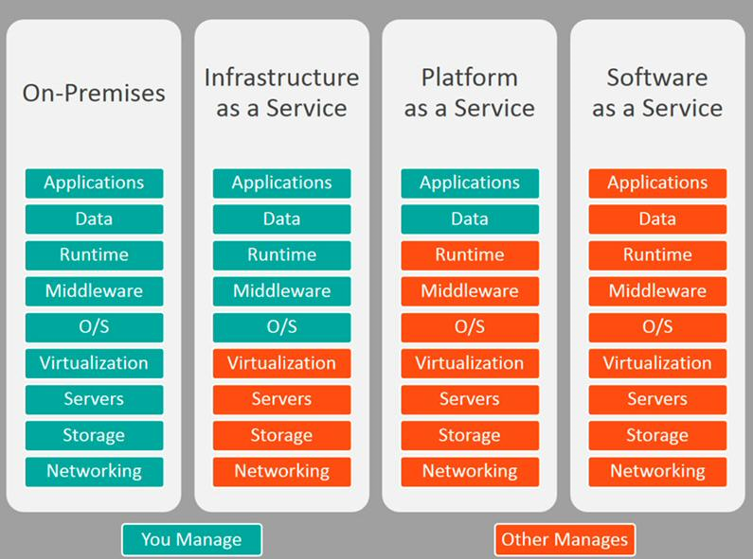
IBM CLOUD
The service used was PAAS
The watson iot platform for device simulation
The IBM iot sensor simulator

Slide 4
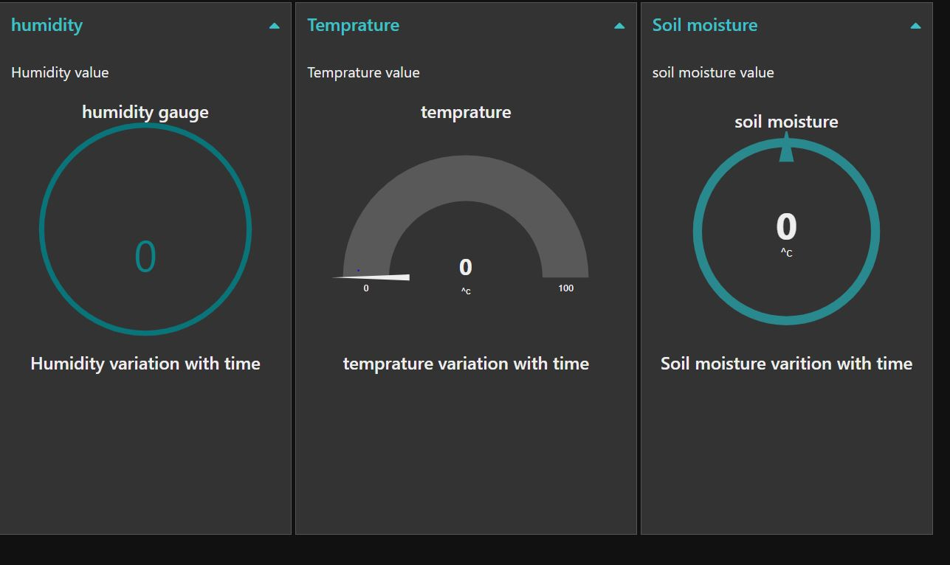
NODE RED AND UI
The node red flow for ibm iot in node
The open weather api flow
The motor on and off and irrigation flow

Slide 5
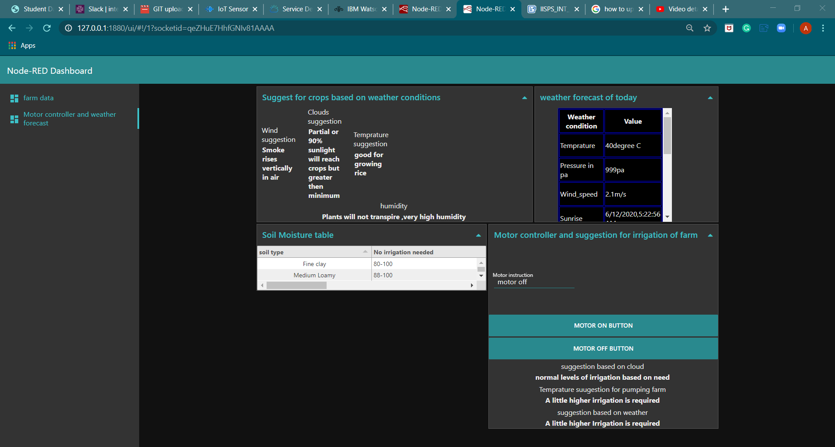
UI TAB 2

